Slide 1
Habit Builder App
Developed by:
Eugenia Almandoz, Paul Ngouchet , Reet Chowdhary , Cameron Fife

Slide 2
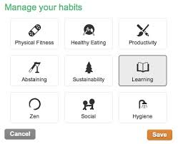
Summary:
Habit Builder provides users with a new way to keep track of their daily success. Our goal for this app was to create an app that would measure the daily progress of a user’s habits. The user would input which activities they wanted to manage for the week and would check them off for each day that they did them. Each activity can be broken down to more specific activities and the same concepts would apply.. This app is intended to help users manage their time and keep track of the number of times an activity/ habit is completed.

Slide 3
Designing the App
Having learned a little bit about data structures in class , we did some research on how to implement a binary tree in our app . Our tree being form of a listViews that expands from top to bottom .

Slide 4
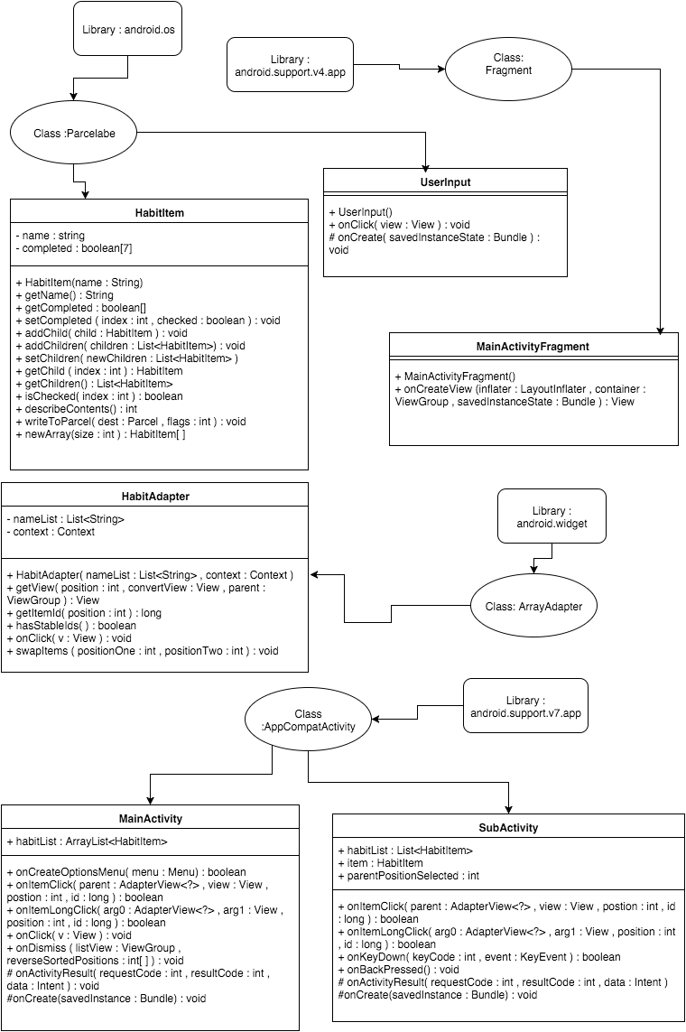
UML Diagram:
This is the UML for the code of our project. The way we presented this is as follows:
Those classes that are defined are those that we created.
The ones in bubbles that say Class are classes we implemented into our code.
Then we also included the libraries we used.

Slide 5
Binary tree of our code :
Note :
This tree can expand at infinity depending on the user’s
preferences
A
B
C
D
E
F
G
In this picture A would be a habit item/ habit and B, C, D would be habit items that are specific to A and continues to branch out like this.
H

Slide 6
Save to file and Loading data
One of the most important aspects of our application was saving the data of our user as he is using it . So that even after quitting the app , he could come back and his data wouldn’t have disappeared . Implementing that need a lot data structuring work , combining binary tree and stacks at the same moment .

Slide 7
Writing To A File:
1)First we implement a breadth - first search to find the lowest tree using a queue .
2)Simultaneously , store each node in a stack such that the lowest right most leaf is popped first and the head is popped last .
3)While popping of the stack , write the to the file so that last/lowest right most leaf is written first and the head is written at the bottom of the file .
4)The file has been successfully written

Slide 8
Reading to a file:
How the data from our app is written to a file!
File:
H
G
F
E
D
C
B
A
*Example File based on the Binary Tree drawn previously
Note : Writing to the file was made from bottom to top . It is better than writing from top to bottom because we don’t have to guess if a root has multiples nodes or not . We just start from the children until we reach the parent .
Reading will just be made from top to bottom , and data will each time be restored . Creating new datas ( actually old datas ) retrieved from the file and running the program with them .
Example:
H Information:
ID: 1
Name: Excercise
Children: None

Slide 9
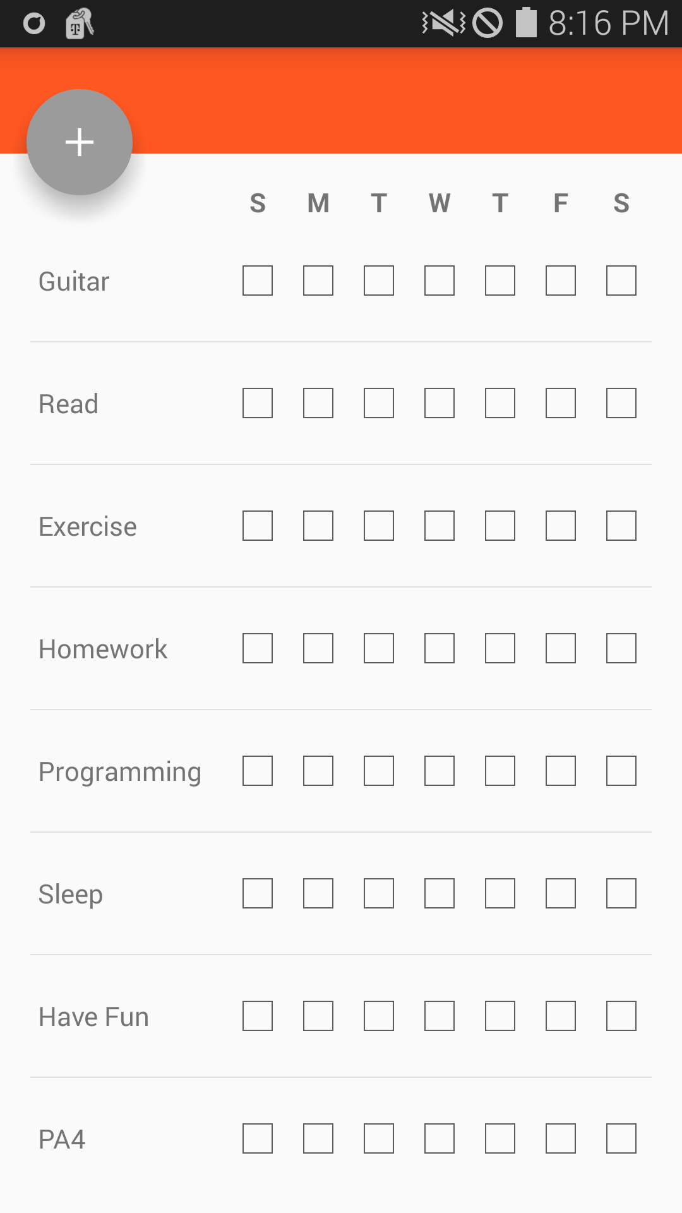
How it works:
Here is a preview of what our app looks like when opened. First it starts as a blank screen since the user has not added any habits to keep track of. We have implemented a button in order to add a habit, which is simply symbolized as a( + ). When added, you can see that it shows what week it is, followed by what you inputted. Next to the activity name 7 checkboxes appear one for each day of the week starting on Sunday.

Slide 10
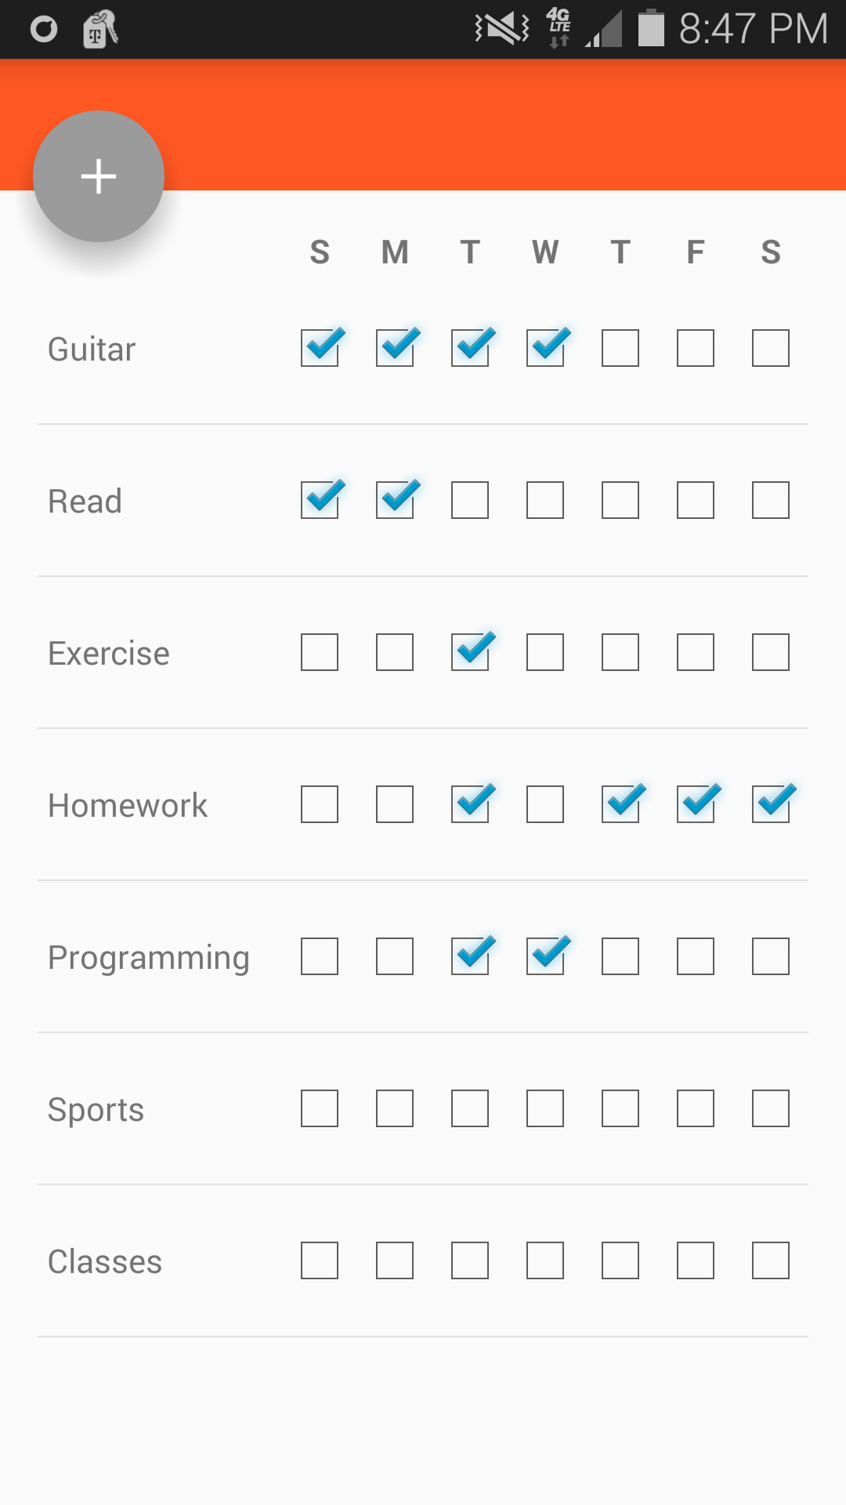
Preview of the list of Activities
Add button
We made adding an activity as natural as possible . In fact all you have to do is press an add button located in left corner and a dialog prompting you to enter your item will pop up . After writing just press Ok , and you have a new activity on your screen .
Having being able to implement a tree in our code . Adding activities and sub activities become limitless .
Days of the week
Example of activity
Checked Checkboxes
Unchecked Checkboxes

Slide 11
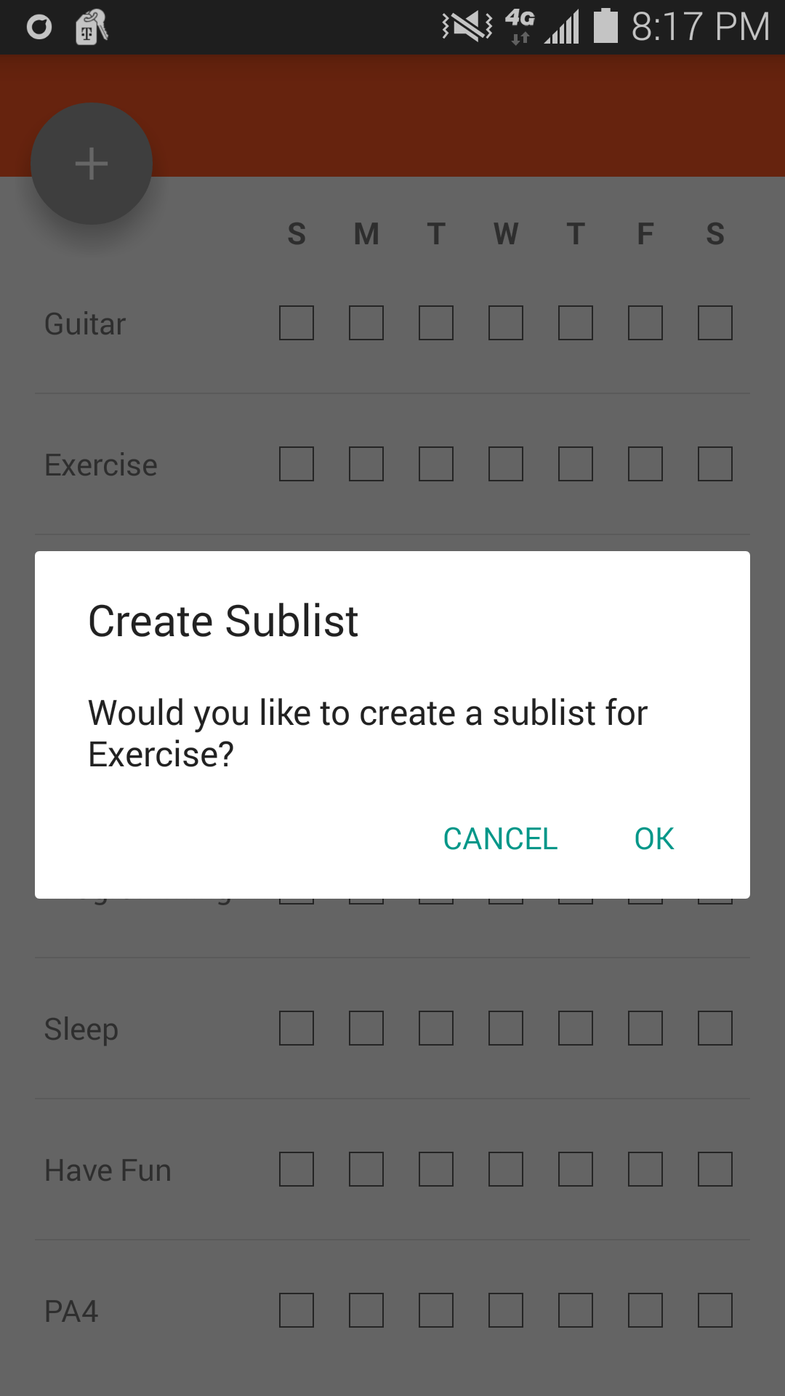
User experience
Contrasting with a complex Back end code , our interface is extremely user friendly . In fact deleting activities , adding activities , Scrolling , rearranging items on the screen is very fluid . To delete an item , the user only needs to scroll right . Taking in account the power of a multi touch screen , we used the long click functionally to give the possibility to the user to swap items . When the user clicks on an activity which doesn’t have sub activities , a dialog pop up on the screen and the user is asked if he wants to add any items to it . If yes he just writes his new items and it is added .

Slide 12
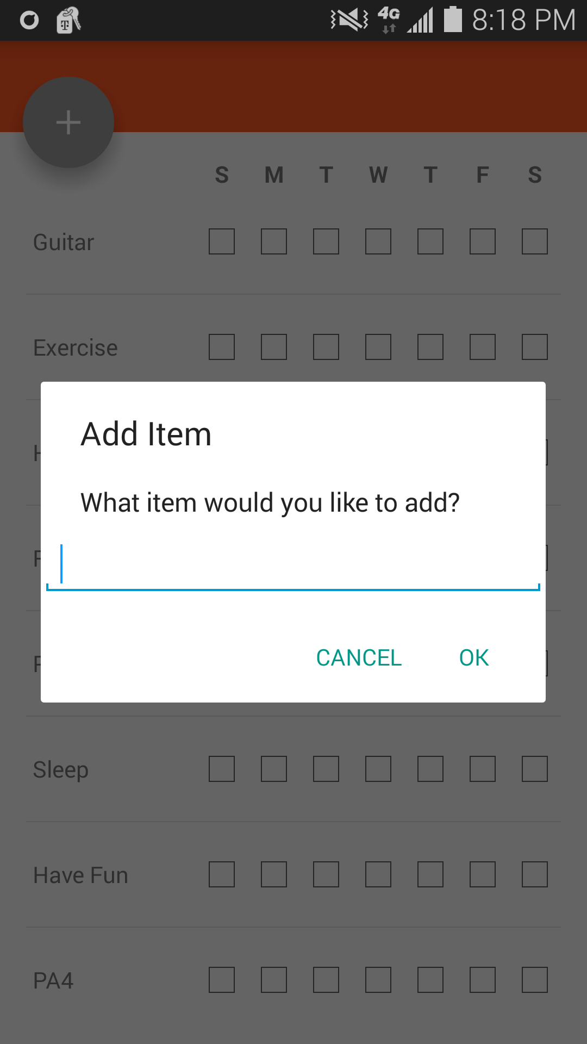
Add Button functionality
This demonstrates how adding a new HabitItem works. This is the screen that shows up when the user clicks on a HabitItem.
User Input: Which HabitItem they want to add
Check if user wants to add it to their view list

Slide 13
What our original plan was:
Due to the time constraint we were not able to implement all the features we wanted to. But here are some of the ones we were thinking of doing:
- Implementing goals and at the end of the week showing which were reached
- Showing what week it is
- Displaying graphs of the user’s success
- Saving to the cloud instead of saving locally
- Implementing a calendar
- Sending notifications to the user

